Slide 1
Leveraging the Open XML SDK to generate documents and reports Brendan Moeller

Slide 2
Presentation Overview
Define Open XML SDK
Overview of WordprocessingML
Open XML SDK and WordprocessingML
Advantages
Demonstrations

Slide 3
What is the Open XML SDK?
A collection of strongly-type classes that can be used to manipulate documents that adhere to the Office Open XML File Formats specification.
Microsoft Office document types that the SDK applies to:
Word documents (docx
Excel spreadsheets (xlsx)
PowerPoint presentations (pptx)
This presentation will cover using the SDK to generate Word documents.
Notes:
Office Open XML
Format based on a collection of xml files zipped up, which form the document
Supported by Office 2007, Office 2010, OpenOffice, Google Docs and other word processing applications

Slide 4
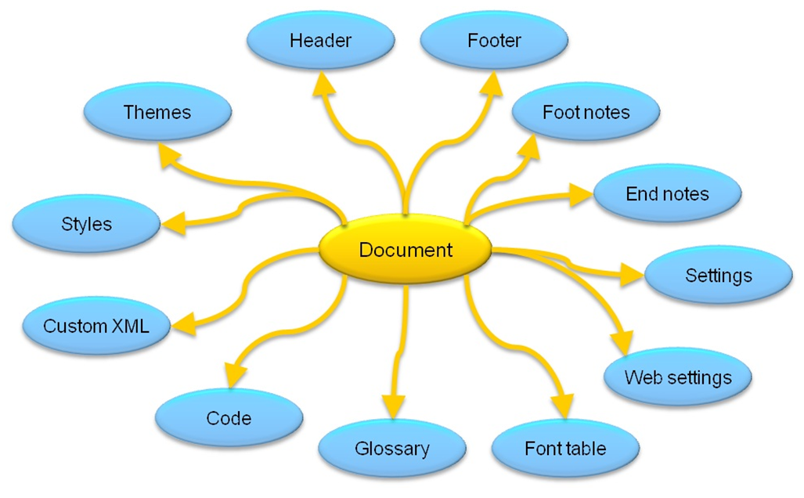
Overview of WordprocessingML
WordprocessingML is the OpenXML format defined for word-processing
It is comprised of a root document and can have many child package parts
Typical document structure
Notes:
After going over this slide show a document opened using the Open XML SDK Tool

Slide 5
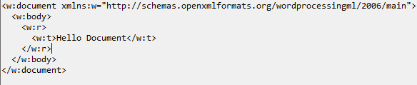
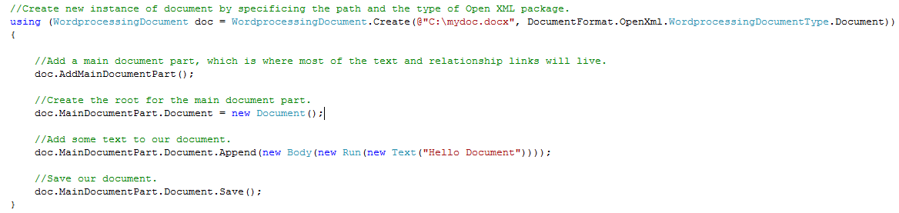
Open XML SDK and WordprocessingML
WordProcessingML
WordProcessingDocument
Notes:
The Open XML SDK acts as a strongly-typed wrapper for WordprocessingML.

Slide 6
Advantages of Open XML SDK
Documents can be created in memory
Classes used by the SDK are all strongly-type.
Minimal setup
Microsoft Word does not need to be installed on the server (still needed for client)
A server process is not required to serve up documents
Required assemblies
DocumentFormat.OpenXML
WindowsBase
Reuse of business logic through existing application assemblies without extra work
Uses LINQ to provide access to objects inside parts of an Open XML document
Open XML SDK Tool
Notes:
Now we’ll look at 2 demos that illustrate the capabilities of the Open XML SDK.

Slide 7
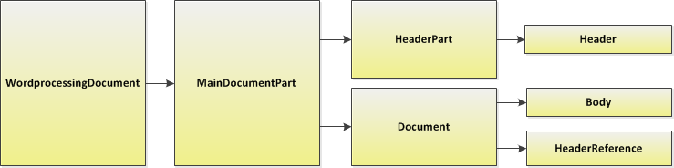
Demo- Manipulate existing document
Open and copy a word processing document that contains a table of bands and time slots for a concert.
Make a change to some of the time slots.
Add a watermark to the document to indicate that it needs to be reviewed
Show the document.
Document Structure
Notes:
Debug demo, show output, show docx in Open XML SDK tool

Slide 8
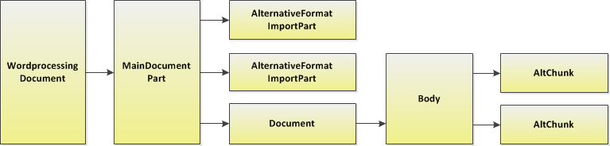
Demo- Generate document with mixed content
Create a new word document
Append html from a rich text editor to the new document
Append the content of an existing word document to the new document.
Show the document.
Document Structure
Notes:
Debug demo, show output, show docx in Open XML SDK tool

Slide 9
Links
Structure of a WordprocessingML Document
http://msdn.microsoft.com/en-us/library/gg278308.aspx
Office Open XML File Formats
http://www.ecma-international.org/publications/standards/Ecma-376.htm
Open XML SDK 2.0
http://www.microsoft.com/downloads/en/details.aspx?FamilyId=C6E744E5-36E9-45F5-8D8C 331DF206E0D0&displaylang=en
Open XML Developer.org
http://openxmldeveloper.org/
Using the Open XML SDK 2.0 Classes Versus Using .NET XML Services
http://msdn.microsoft.com/en-us/library/ee361882(office.12).aspx
Notes:
Structure of a WordprocessingML Document- an overview of the structure of WordprocessingML and the more common Open XML SDK classes that are used to generated word processing documents.
Office Open XML File Formats- more information on the Office Open XML File Formats standards.
Open XML Developer.org- offers a forum and knowledge base for those developing with the SDK.
Using the Open XML SDK 2.0 Classes Versus Using .NET XML Services- benefits of using the Open XML SDK.
Then Extra if there is time and stuff to give away.

Slide 10
Questions
bmoeller@sogeti.com
Notes:
Structure of a WordprocessingML Document- an overview of the structure of WordprocessingML and the more common Open XML SDK classes that are used to generated word processing documents.
Office Open XML File Formats- more information on the Office Open XML File Formats standards.
Open XML Developer.org- offers a forum and knowledge base for those developing with the SDK.
Using the Open XML SDK 2.0 Classes Versus Using .NET XML Services- benefits of using the Open XML SDK.
Then Extra if there is time and stuff to give away.

Slide 11
Thank you

